Slide 1
NVIDIA Tegra K1 系统组成及架构特点
刘寿生
2015/12

Slide 2
目录
TK1组成部分
TK1组成原理
TK1系统结构特点
TK1硬件和性能指标
附录
Notes:
组成部分
组成原理
系统结构特点
硬件和性能指标
附录

Slide 3
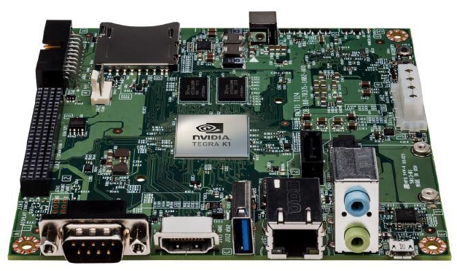

TK1组成部分 ——概览

Slide 4
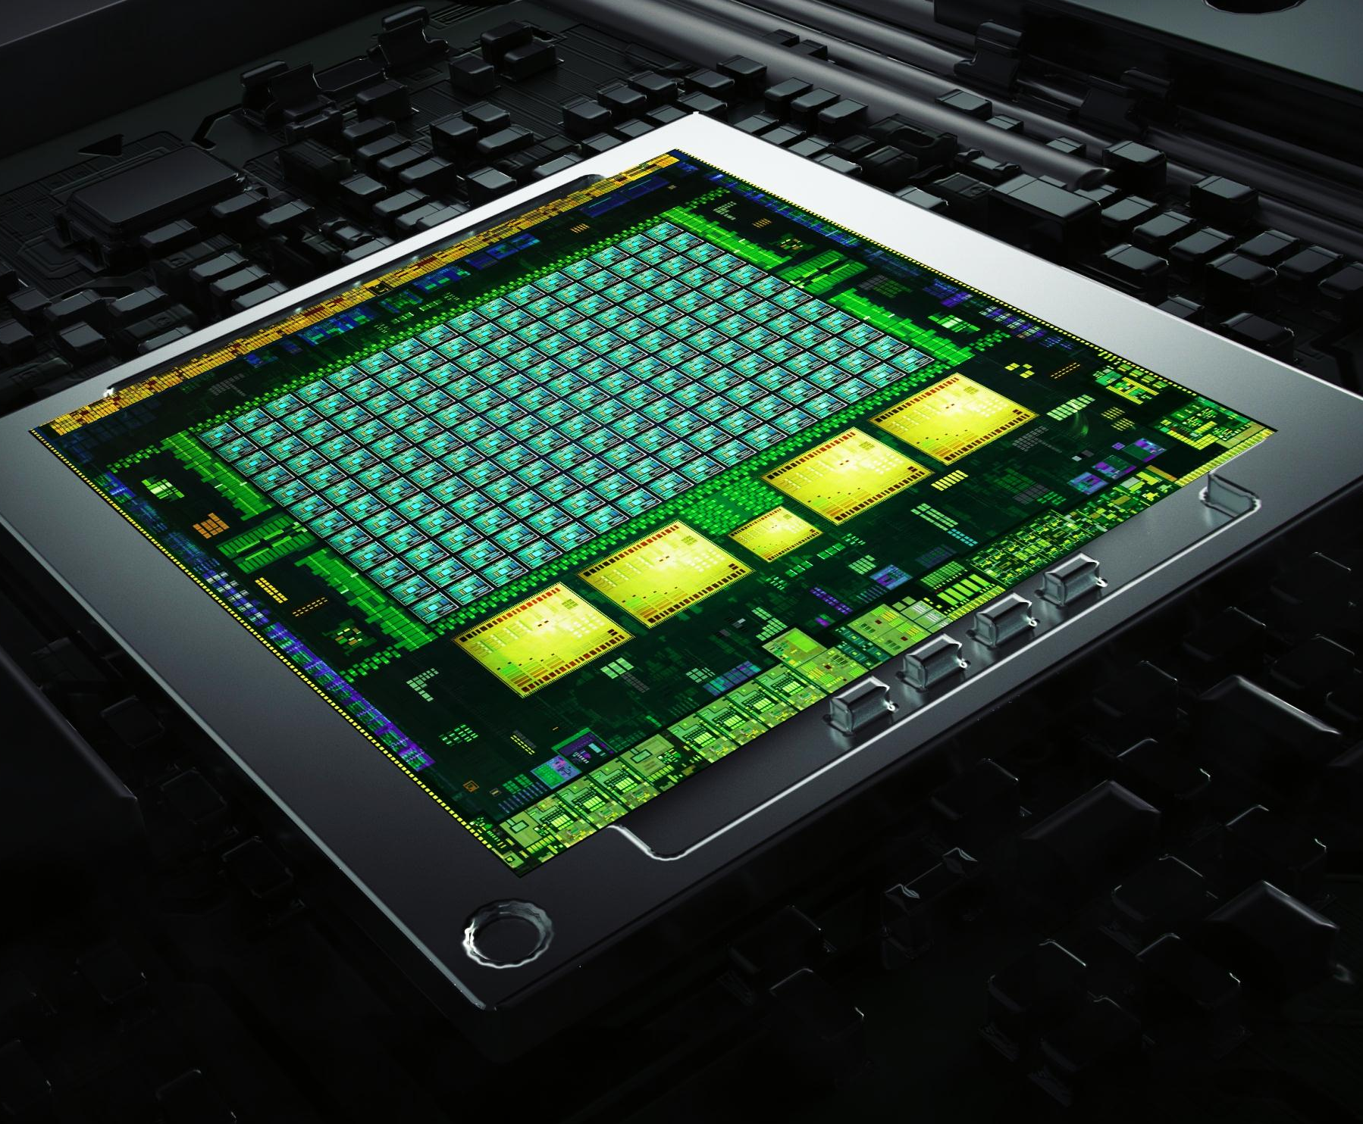
TK1组成部分 ——处理器
处理器
GPU
192 CUDA核心
Kepler 架构
2G 显存
326 GFLOPS
4K 分辨率
CPU
4-Plus-1 四大一小核心
ARM Cortex A15 架构
功耗：5W
Notes:
参考：
https://developer.nvidia.com/jetson-tk1
http://elinux.org/Jetson_TK1

Slide 5
TK1组成部分 ——内存IO
内存
Memory 存储器
2G 内存
16G 外存
IO接口
I基本接口
USB / HDMI / LAN
特色接口
RS232 / SATA / Audio
PCI-E / JTAG / GPIOs
Notes:
参考：
https://developer.nvidia.com/jetson-tk1
http://elinux.org/Jetson_TK1

Slide 6
TK1组成部分 ——模块图
USB 2.0 micro B
Tegra K1
SOC
HDMI
USB 3.0
A
SATA
A15
GK20A
192 CUDA Cores
A15
Mini PCIe x1
A15
ALC5639 Audio Codec
Line Out
A15
GigE
RTL8111GS PEX - GigE
Arm7
MIC In
ISP
Audio
HD Video
JTAG
SD/MMC
2 GB
DDR3
16 GB eMMC
Expansion Port (DP/LVDS, Touch SPI, I2C, CSI x1, CSI x4, GPIO 6:0)
AS3722
PMIC

Slide 7
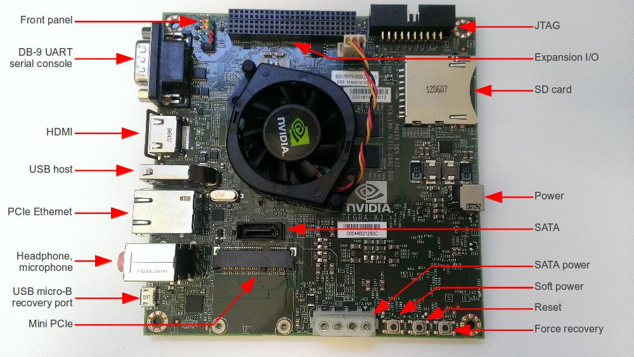
TK1组成部分 ——实物/模块示意图

Slide 8
TK1组成原理 ——操作系统
Linux for Tegra (L4T)
基于Ubuntu 14.04
OpenGL 4.4
VisionWorks —— ADAS辅助驾驶系统，AR增强现实，HMI人机交互，机器人
Notes:
参考：
https://developer.nvidia.com/jetson-tk1
http://elinux.org/Jetson_TK1

Slide 9
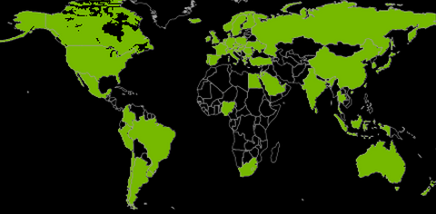
TK1组成原理 ——并行编程平台CUDA
Institutions with
CUDA Developers
738 University Courses
In 62 Countries
8,000
2,200,000
Toolkit Downloads
506,000,000
GPUs Shipped
Notes:
395M CUDA GPUS: GPUs shipped as of 7/1/2012

Slide 10
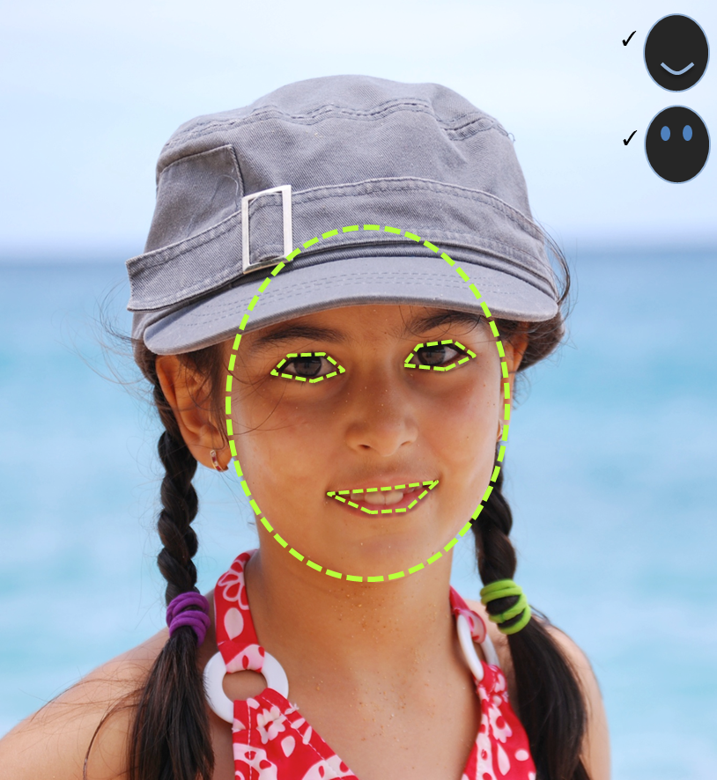
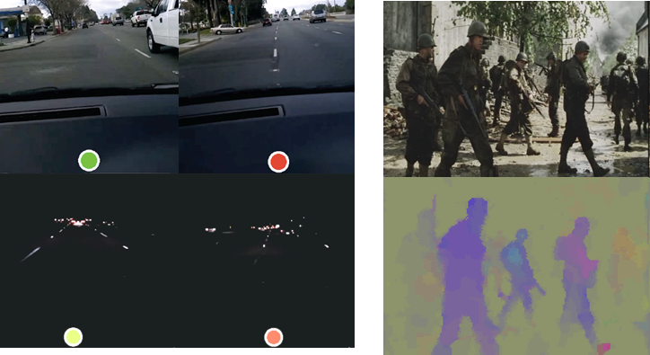
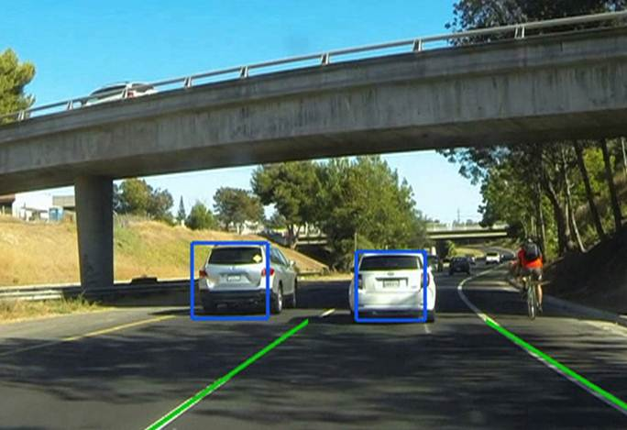

TK1组成原理 ——计算视觉应用开发平台VISIONWORKS
SDK for CV and Image Processing
Optimized for CUDA-enabled GPUs and SOCs
Example CV pipelines with source
Open and extensible architecture
Jetson TK1 compatibility out-of-the-box
VisionWorks
CUDA
OS

Slide 11
TK1组成原理 —— VISIONWORKS PRIMITIVES组件
Sobel
Convolve
Bilateral Filter
Integral Image
Integral Histogram
Corner Harris
Corner FAST
Image Pyramid
Optical Flow PyrLK
Optical Flow Farneback
Warp Perspective
Hough Lines
Fast NLM Denoising
Stereo Block Matching
IME (Iterative Motion Estimation)
HOG (Histogram of Oriented Gradients)
Soft Cascade Detector
Object Tracker
TLD Object Tracker
SLAM
Path Estimator
MedianFlow Estimator

Slide 12



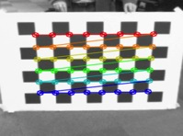
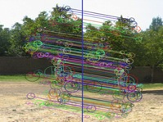

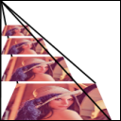




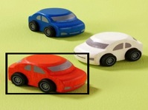
TK1组成原理 —— OPENCV
Portable, open API
900+ functions
OpenCV4Tegra - Accelerated CUDA+NEON+GLSL+TBB multithreading
Image processing
Video, Stereo, and 3D
General Image Processing
Segmentation
Machine Learning, Detection
Camera Calibration
Features
Depth Maps
Image Pyramids
Transforms
Fitting
Optical Flow
Inpainting
Tracking

Slide 13
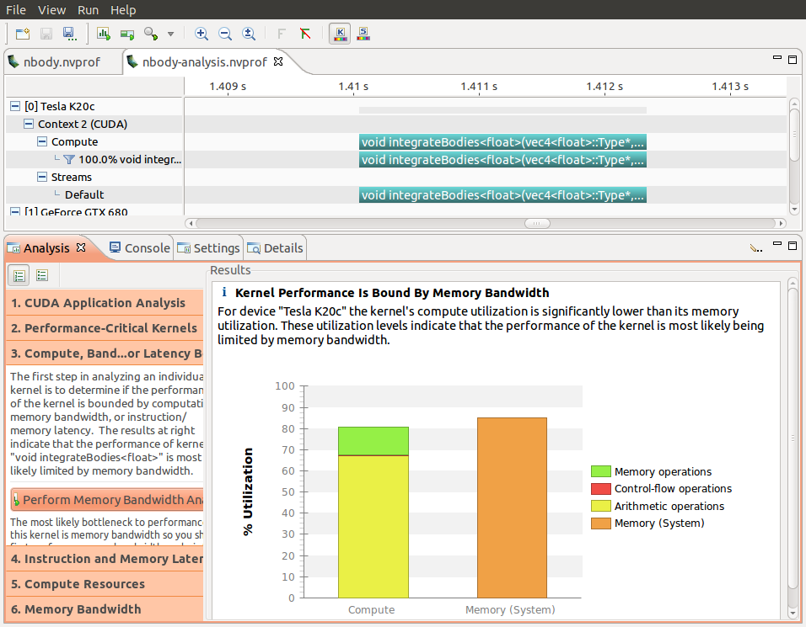
TK1组成原理 —— 丰富的开发调试环境
Nsight Eclipse Edition IDE
NVIDIA Visual Profiler
Native compiler, debugger, profiler
CUDA-enabled libraries (cuFFT, cuBLAS, cuSparse, etc)

Slide 14
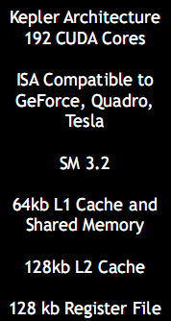
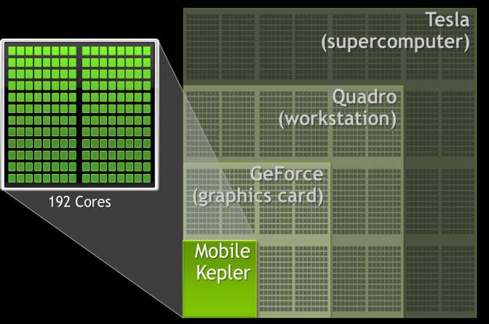
TK1系统结构特点 ——高性能移动/嵌入式GPU
Notes:
参考：
https://developer.nvidia.com/jetson-tk1
http://elinux.org/Jetson_TK1

Slide 15
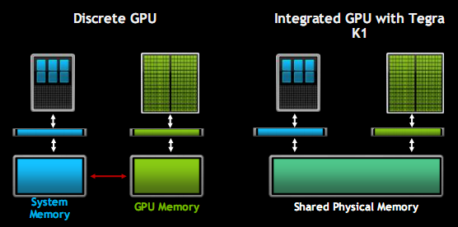
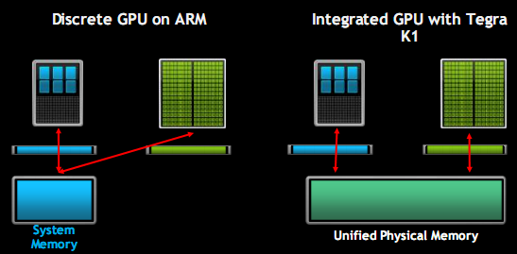
TK1系统结构特点 ——一致化内显存（Unified Memory)
Notes:
参考：
https://developer.nvidia.com/jetson-tk1
http://elinux.org/Jetson_TK1

Slide 16
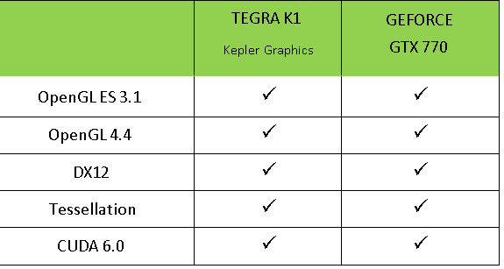
TK1系统结构特点 ——丰富的GPU可编程API

Slide 17
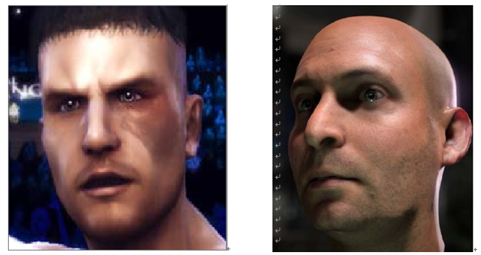
TK1系统结构特点 ——支持OpenGL4.4
OpenGL对比
OpenGL 3.0 ES
vs
OpenGL 4.x
Notes:
参考：
https://developer.nvidia.com/jetson-tk1
http://elinux.org/Jetson_TK1

Slide 18
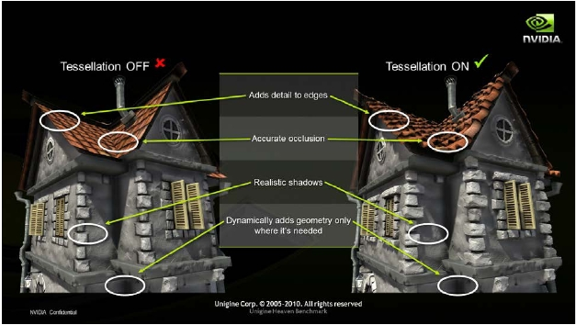
TK1系统结构特点 ——支持Tessellation曲面细分
Tessellation
一般嵌入式/移动处理器不支持
vs
TK1支持
Notes:
参考：
https://developer.nvidia.com/jetson-tk1
http://elinux.org/Jetson_TK1

Slide 19
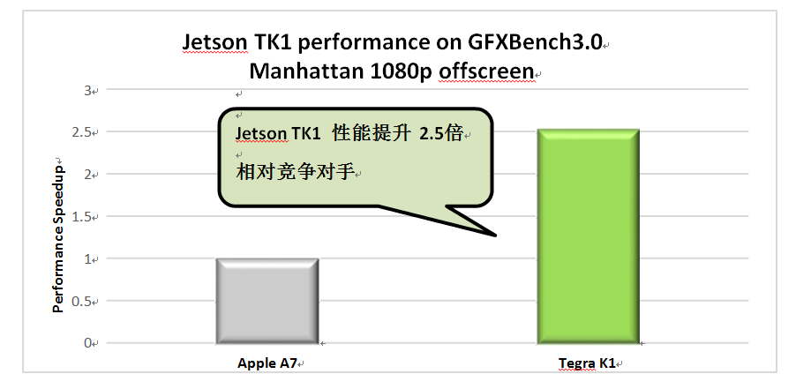
TK1性能指标 ——NVIDIA TK1 vs Apple A7
Notes:
参考：
https://developer.nvidia.com/jetson-tk1
http://elinux.org/Jetson_TK1

Slide 20
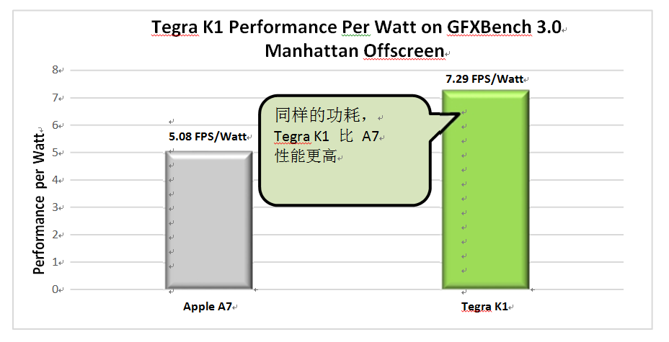
TK1性能指标 ——NVIDIA TK1 vs Apple A7
Notes:
参考：
https://developer.nvidia.com/jetson-tk1
http://elinux.org/Jetson_TK1

Slide 21
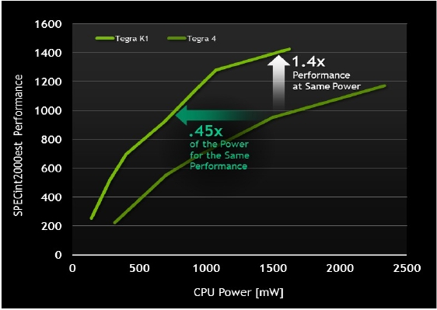
TK1性能指标 ——Tegra K1 vs Tegra 4
同型号对比
Tegra K1
vs
Tegra 4
Notes:
参考：
https://developer.nvidia.com/jetson-tk1
http://elinux.org/Jetson_TK1

